Slide 1
Distributed Systems
Reliable Queueing Platform
A. Y. 2023/2024
Project developed by Matteo Figini and Fabrizio Monti
https://github.com/matteo-figini/ds-queuing-system

Slide 2
Project goal
To implement a distributed and reliable queuing platform where a set of brokers collaborate to offer multiple queues to multiple clients.
Queues are persistent, append only, FIFO data structures.
Multiple (not necessarily every) brokers replicate the data of queues to guarantee fault tolerance and high availability in case one of them crashes
Clients connect to brokers to create new queues, append new data (integer values) on an existing queue, or read data from a queue.
Each client is uniquely identified and the brokers are responsible for keeping track of the next data element each client should read

Slide 3
Assumptions
Links are assumed to be reliable, while nodes (brokers) may fail (crash failures)
Nodes running brokers holds a stable storage (the file system) that can be assumed to be reliable

Slide 4
Network architecture: locator
The first element that is initialized in the network is the Locator
It is responsible for keeping track of all the connected nodes (brokers & clients), and to provide (limited) support for network utilities, e.g.:
  A broker should connect to the other ready brokers → locator provides the list of brokers
  A client should know who is the brokers’ leader → locator provides the reference to the leader
Due to the very limited functionalities of the locator and the lack of application logic, we assume it to be the only reliable element of our network.

Slide 5
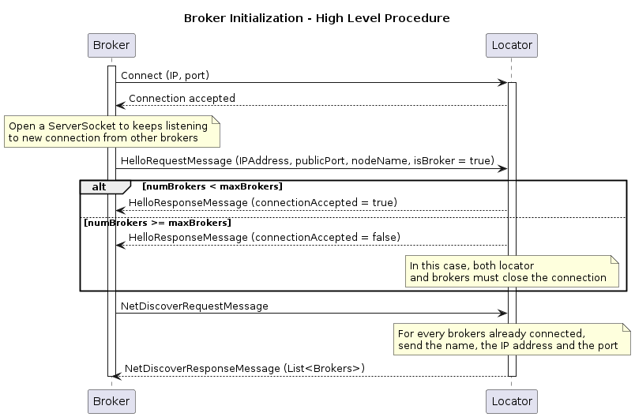
Network architecture: brokers
Brokers connect first to the locator, to be part of the network, then they contact the locator (NetDiscoveryRequestMessage) to know whether other brokers are already connected
Every broker can act both as client and as server to other brokers:
  A broker acts as a client w.r.t. all the other brokers already connected
  A broker acts as a server w.r.t. all the other brokers that connect afterwards
  All the application messages are exchanged directly among brokers, (i.e. without the help of the locator)

Slide 6
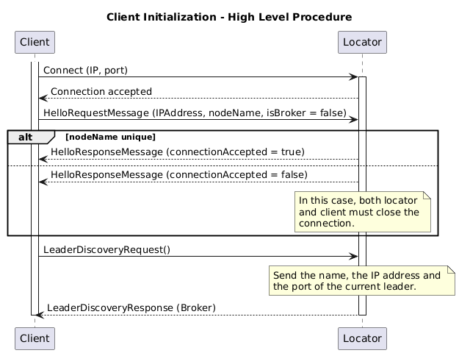
Network architecture: client
Brokers connect first to the locator, to be part of the network, then they contact the locator (LeaderDiscoveryRequest) to know who is the brokers’ leader, which is responsible for the communication with the clients.
Clients send application messages directly to the leader, while they contact the locator in case of exceptional situations (i.e. leader disconnected)

Slide 7
(Modified) Raft
To provide consistency among the brokers while having fault tolerance, we implemented a slightly changed version of the Raft protocol to the communication among brokers.
In detail, we removed the heartbeat among brokers in favour of directly listening on the socket disconnection events, to simplify the communication among the brokers and to reduce the traffic

Slide 8
Application features
<completare>

Slide 9
How to play with the project
create <queue_name>
  Creates a new queue with the name specified as parameter queue_name. In case the queue is already present, a warning is returned as response.
append <queue_name> <int_1> <int_2> … <int_n>
  Append to the queue specified as parameter queue_name the integer values specified afterwards, separated by a space.
  A warning is returned in case the queue is unknown.
read <queue_name>
  Read all the values from the queue specified as parameter queue_name that are not yet read by the client.
  A warning is returned in case the queue is unknown or if no new elements from the queue need to be read.

Slide 10
References
D. Ongaro, J. Ousterhout “In Search of an Understandable Consensus Algorithm” USENIX Annual Technical Conference, 2014: https://raft.github.io/
Martin Kleppmann’s lecture on Raft protocol: https://www.youtube.com/watch?v=uXEYuDwm7e4

